Slide 1
ARRAYS example: THE GAME OF LIFE
CITS1001

Slide 2
Scope of this lecture
Software design
Case study: The Game of Life
Implementation
Performance Issues
References:
http://en.wikipedia.org/wiki/Conway%27s_Game_of_Life
http://www.bitstorm.org/gameoflife/
(and hundreds of other websites)

Slide 3
Software maintenance
Software is not like a novel that is written once and then is left unchanged for the ages
After it is “finished”, software is corrected, extended, ported, adapted, translated, …
This activity is collectively known as maintenance
This work is done by different people at different times, sometimes over years or even decades
There are only two options for software
It changes and adapts, or it dies

Slide 4
Software design principles
Two important concepts in software design are coupling and cohesion
Coupling refers to the links between different parts of a program
If two classes depend closely on many details of each other’s workings, we say that they are tightly-coupled
We aim for loose coupling; this allows different parts of the program to be worked-on independently
Cohesion refers to the number and diversity of tasks that a single class is responsible for
If a class is responsible for a single logically-contained task, we say that it has high cohesion
We aim for high cohesion; this promotes reliability and understandability

Slide 5
The Game of Life
Invented by John Conway nearly fifty years ago
An example of a cellular automaton
The game is played on a rectangular grid of “cells”

Slide 6
A model world
This grid is a “model world”, where each cell is either occupied or vacant
The initial configuration can be specified by the user, or chosen randomly
We colour the occupied cells, and leave the others blank; the colour scheme is irrelevant to the game, but it makes the application look more attractive

Slide 7
Births and Deaths
In this model world, time passes in discrete steps known as generations
The beginning of time is Generation 0
At each time step, the occupants of the model world live or die according to the following rules:
any individual with zero or one neighbours dies of loneliness
any individual with four or more neighbours dies of overcrowding
a new individual is born in any unoccupied cell with exactly three neighbours
The neighbours of a cell are the occupants of the eight cells surrounding that particular cell

Slide 8
Example
0
0
0
0
0
1
2
3
2
1
1
1
2
1
1
1
2
3
2
1
0
0
0
0
0
Initial configuration
Number of neighbours of each cell
Next generation

Slide 9
Interpretation
The occupants of these cells died of loneliness
0
0
0
0
0
1
2
3
2
1
1
1
2
1
1
These two are new-born “babies”
1
2
3
2
1
0
0
0
0
0

Slide 11
At the edges
The edges of the world are assumed to “wrap around”, so the map is actually a flat map of a torus-shaped world
Neighbourhoods

Slide 12
Program Specification
We want a program that allows a user to experiment with The Game of Life
To set up specific configurations
Or to have a configuration provided for them
To run some (controllable) number of generations
Or simply to animate a configuration
Other possibilities might occur to you
e.g. to animate a configuration and to test it for stability or for other properties
e.g. to compare two configurations in some way

Slide 13
Program Design
The program needs classes to perform the following operations
Maintain and update the map of the world
Display and update the screen view of the world
We will design two classes for these two aspects, and use a SimpleCanvas to provide the display
Therefore we will create two classes
Life
LifeViewer

Slide 14
Separate the responsibilities
The Life class should
Maintain the current map of the world
Update to the “next generation” when requested
Provide access to the map for client use
The LifeViewer class should
Create a SimpleCanvas to display the map
Display the initial generation
Animate a client-specified number of generations

Slide 15
The Life instance variables
public class Life
{
private boolean[][] map;
private int width, height;
// constructors & methods
}
We use a 2D array of type boolean for the map of the world; the value of the [i][j] entry in the array map indicates whether the (i,j) cell is populated or not

Slide 16
The first constructor
public Life(boolean[][] initial) {
map = initial;
width = map.length;
height = map[0].length;
}
This constructor allows the client to create a Life object with any initial pattern of occupied and unoccupied cells that they want

Slide 17
The second constructor
public Life(int width, int height, double probability) {
map = new boolean[width][height];
this.width = width;
this.height = height;
initializeMap(probability);
}
This constructor allows the client to specify just the width and height and to have a random starting configuration created

Slide 18
Private helper method for initializing
private void initializeMap(double probability) {
for (int i = 0; i < width; i++)
for (int j = 0; j < height; j++)
map[i][j] = Math.random() < probability;
}
If the user specifies 0.2 as the probability, approximately 20% of the cells will be occupied
Math.random() is a quick way to get random doubles between 0 and 1

Slide 19
The default constructor
It is polite to also give a “default” constructor for users who just wish to get going quickly, and are willing to accept programmer-chosen values
public Life() {
this(128, 128, 0.1);
}
Calls the 3-argument constructor with 128, 128, and 0.1 as the values

Slide 20
A new generation
public void nextGeneration() {
boolean[][] nextMap = new boolean[width][height];
for (int i = 0; i < width; i++)
for (int j = 0; j < height; j++)
switch (numNeighbours(i, j)) {
case 2: nextMap[i][j] = map[i][j]; break;
case 3: nextMap[i][j] = true; break;
default: nextMap[i][j] = false;
}
map = nextMap;
}

Slide 21
Code Dissection
boolean[][] nextMap = new boolean[width][height];
This creates the space for the “next generation” to be stored in; we use the instance variables width and height to set the size
We cannot do the updating “in place” because the rules specify that the updating from generation to generation occurs over the entire grid simultaneously; we cannot change some values and then use the new values in the calculation for other cells

Slide 22
Code dissection
We haven’t defined this method yet
switch (numNeighbours(i, j)) {
case 2: nextMap[i][j] = map[i][j]; break;
case 3: nextMap[i][j] = true; break;
default: nextMap[i][j] = false;
}
The main loop processes each cell (i,j) in turn. The number of neighbours is calculated and the (i,j) cell of nextMap is set according to the rules of the Game of Life

Slide 23
Code dissection
map = nextMap;
The final statement makes the instance variable map refer to the newly completed “next generation” nextMap. Now everything is correctly updated.

Slide 24
Counting the neighbours
private int numNeighbours(int i, int j) {
int n=0;
int ip = (i + 1) % width;
int im = (width + i - 1) % width;
int jp = (j + 1) % height;
int jm = (height + j - 1) % height;
if (map[im][jm]) n++; if (map[im][j]) n++;
if (map[im][jp]) n++; if (map[i][jm]) n++;
if (map[i][jp]) n++; if (map[ip][jm]) n++;
if (map[ip][j]) n++; if (map[ip][jp]) n++;
return n;
}

Slide 25
Code Dissection
[i-1][j-1]
[i][j-1]
[i+1][j-1]
int ip = (i+1) % width;
int im = (width+i-1) % width;
int jp = (j+1) % height;
int jm = (height+j-1) % height;
[i-1][j]
[i][j]
[i+1][j]
[i-1][j+1]
[i][j+1]
[i+1][j+1]
Here, ip, im, jp, and jm refer to i+1, i-1, j+1 and j-1 respectively

Slide 26
Dealing with wrap-around
When i is equal to width-1, then i+1 is equal to width, which is off the right-hand side of the picture.
Calculating (i+1)%width has the effect of “wrapping around” back to 0, which is what is needed.
Similarly when i is equal to 0, then (width+i-1)%width “wraps around” back to width-1.
(i,j)

Slide 27
More dissection
if (map[im][jm]) n++;
if (map[im][j]) n++;
if (map[im][jp]) n++;
if (map[i][jm]) n++;
if (map[i][jp]) n++;
if (map[ip][jm]) n++;
if (map[ip][j]) n++;
if (map[ip][jp]) n++;
return n;
This is simply eight if statements that increment the variable n if the corresponding cell is occupied.
Finally n is returned.
Notice that the method is private, and only to be used by the Life object itself.

Slide 28

One performance issue
As written, this code consumes a large amount of memory
map
nextMap

Slide 29
What happens during the update?
After the statement map = nextMap;
map
nextMap

Slide 30
When the method finishes
The variable nextMap disappears
map
This area of memory is now “garbage”

Slide 31
Garbage Collection
Java will automatically “collect” the garbage for you and recycle the space, but there is a performance penalty associated with this
If the world is large and you are simulating many generations, the memory will rapidly fill up and the garbage collector will interrupt the smooth “animation”
To fix this, it is better to keep two “maps of the world” as instance variables and just swap them over at each generation
private boolean[][] map, nextMap;

Slide 32
In the nextGeneration() method
Delete the code
boolean[][] nextMap = new boolean[width][height];
because we do not want to create a new array every generation, but instead re-use the instance variable nextMap
Replace
map = nextMap;
with
boolean[][] swap = map;
map = nextMap;
nextMap = swap;

Slide 33
How does this work?
map
nextMap
swap
swap = map;

Slide 34
Contd.
map
nextMap
swap
map = nextMap;

Slide 35
Contd.
map
nextMap
swap
nextMap = swap;

Slide 36
When the method finishes
map
nextMap
swap disappears

Slide 37
Program Design
Recall that our program design called for three classes
Life
LifeViewer
SimpleCanvas
The internal structure of the Life class has been written
Now we must decide
How the LifeViewer interacts with the Life object
The internal structure of the LifeViewer object

Slide 38
Interaction
The LifeViewer needs the Life object to do the following:
Send the data for the current generation to be displayed
Update to the next generation when required
This means that the Life class must have the following public methods
public boolean[][] getMap()
When called, this will return the array representing the current map
public void nextGeneration()
When called, this will update the Life object to the next generation

Slide 39
The extra method for Life
public boolean[][] getMap() {
return map;
}
Very simple method; returns a reference to the array representing the current generation

Slide 40
Variables defined in LifeViewer
public class LifeViewer {
private Life life;
private int width, height;
private SimpleCanvas c;
private final static int CELL_SIZE = 4;
private final static Color BACK_COLOUR = Color.white;
private final static Color CELL_COLOUR = Color.red;
private final static Color GRID_COLOUR = Color.black;

Slide 41
Instance Variables for LifeViewer
public class LifeViewer {
private Life life;
private int width, height;
private SimpleCanvas c;
Each LifeViewer is responsible for displaying one Life object
The width and height are stored as instance variables for convenience
Each LifeViewer has one SimpleCanvas on which to draw

Slide 42
Class Variables for LifeViewer
private final static int CELL_SIZE = 4;
private final static Color BACK_COLOUR = Color.white;
private final static Color CELL_COLOUR = Color.red;
private final static Color GRID_COLOUR = Color.black;
Here we define useful constants for the size of the cells and the colours to be used for the drawing. They are declared final because they will not change during one run of the program.

Slide 43
The constructor for LifeViewer
public LifeViewer(Life life) {
this.life = life;
width = life.getMap().length;
height = life.getMap()[0].length;
c = new SimpleCanvas("Life", width * CELL_SIZE + 1,
height * CELL_SIZE + 1, BACK_COLOUR);
display();
}

Slide 44
What the constructor does
The user must
pass the LifeViewer
an instance of Life
to be displayed
public LifeViewer(Life life) {
this.life = life;
width = life.getMap().length;
height = life.getMap()[0].length;
The constructor’s job is to initialize all the instance variables; the argument is an instance of the class Life, and so this must be saved in the corresponding instance variable. The width and height variables are then determined by asking the life object for a reference to its 2-d boolean array, and finding its dimensions

Slide 45
The constructor for LifeViewer
c = new SimpleCanvas("Life", width * CELL_SIZE + 1,
height * CELL_SIZE + 1, BACK_COLOUR);
We need the “+1” to give the right hand edge and the bottom edge a nice border
CELL_SIZE
CELL_SIZE
CELL_SIZE
+1

Slide 46
Displaying the Life object
Now we need a method to display the Life object
This is basically three steps
get the current map from the Life object
draw the appropriate picture on the drawing area, which will involve painting every cell of the grid the right colour
call c.repaint() to have the drawing rendered to the screen
(It would be better to re-draw only the cells which have changed in the latest generation – how would you do that?)

Slide 47
A method to display the Life object
private void display() {
drawCells();
drawGrid();
c.repaint();
}
Notice how the displaying functions – drawing the cells and drawing the grid – are all migrated to separate methods; this makes for code that is easy to read and to update

Slide 48
Drawing the cells
private void drawCells() {
Color col;
for (int i = 0; i < width; i++)
for (int j = 0; j < height; j++) {
if (life.getMap()[i][j]) col = CELL_COLUR;
else col = BACK_COLOUR;
c.setForegroundColour(col);
c.drawRectangle(i * CELL_SIZE, j * CELL_SIZE,
(i+1) * CELL_SIZE, (j+1) * CELL_SIZE);
}
}
For each cell in the array, set the colour and draw a rectangle of that colour at the appropriate coordinates

Slide 49
Drawing the grid
Draw the vertical grid lines (constant x-values, full height)
private void drawGrid() {
c.setForegroundColour(GRID_COLOUR);
for (int i = 0; i <= width; i++)
c.drawLine(i * CELL_SIZE, 0,
i * CELL_SIZE, height * CELL_SIZE);
for (int j = 0; j <= height; j++)
c.drawLine(0, j * CELL_SIZE,
width * CELL_SIZE, j * CELL_SIZE);
}
Why <=? Because if there are n cells, we want n+1 lines in the grid (to include the edges)
Draw the horizontal grid lines (constant y-values, full width)

Slide 50
Animating the display
public void animate(int n) {
for (int i=0; i < n; i++) {
life.nextGeneration();
display();
c.wait(250);
}
}
The only public method is the one that allows the user to specify that they want to see n generations of “The Game of Life”; it is a simple loop that asks the Life object to calculate the next generation, displays it, and waits briefly to give an “animated” effect

Slide 51
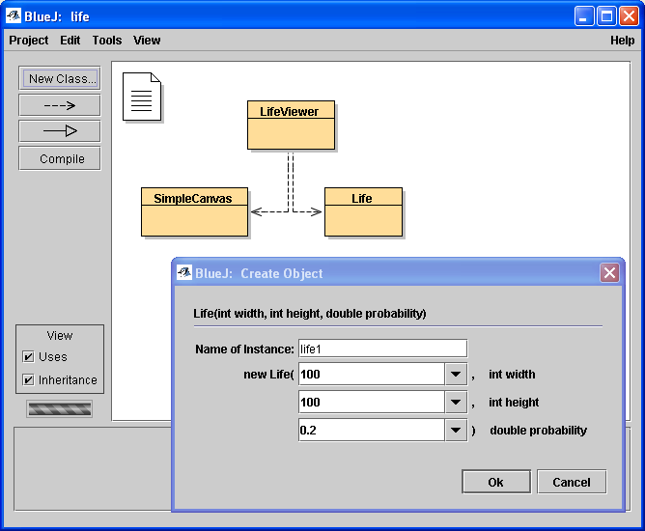
Create the Life object

Slide 52
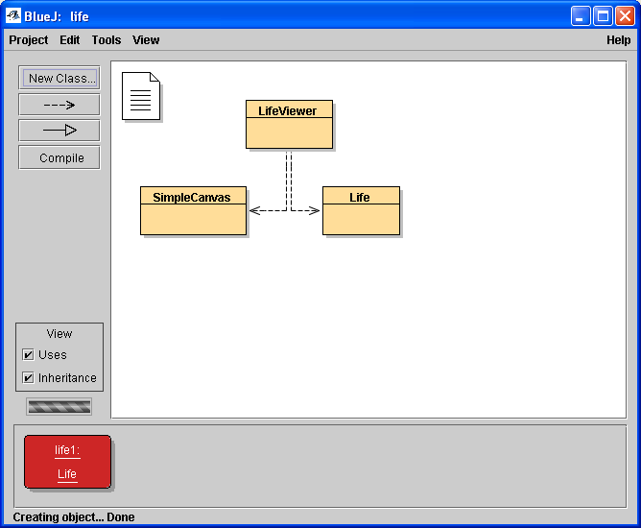
It appears on the workbench

Slide 53
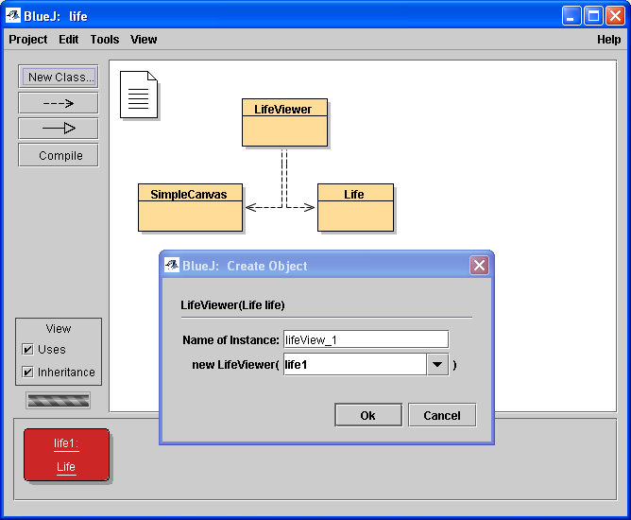
Now create a LifeViewer to view it

Slide 54
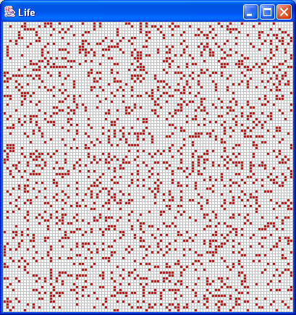
The initial randomly chosen configuration is displayed on a SimpleCanvas

Slide 55
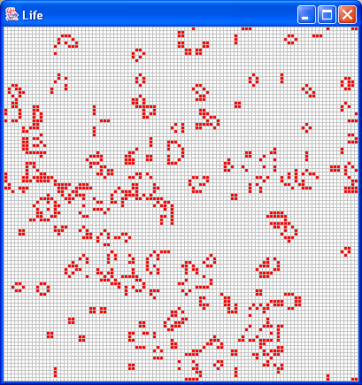
After 100 generations, the map looks a bit more “organized”

Slide 56
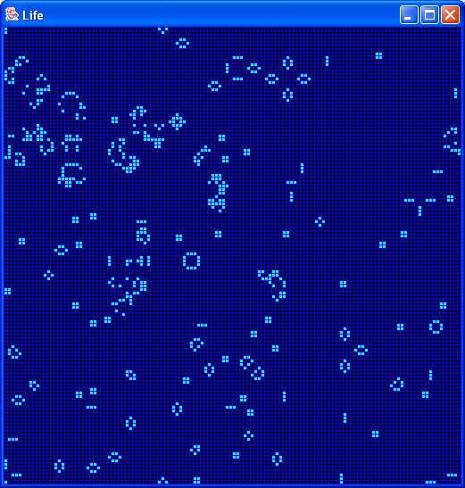
A new colour scheme can be obtained just by changing the three constants

